Slide 1

Fondation Merieux in SEA
Dr. Nay THI HA
SEA- Regional Representative
23rd May 2023

Slide 2
Outline
Who we are?
Research related activities
Expertise
Perspectives

Slide 3

A Family Foundation Serving Public Health
Official public interest status since 1976

Slide 4
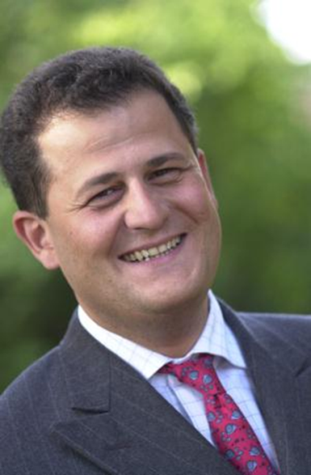
Mission
Strengthen local capacities to fight the infectious diseases that affect vulnerable populations in developing countries, particularly mothers and children.
The Mérieux Foundation works in symbiosis with Fondation Christophe et Rodolphe Mérieux, a family foundation under the auspices of the Institut de France

Slide 5

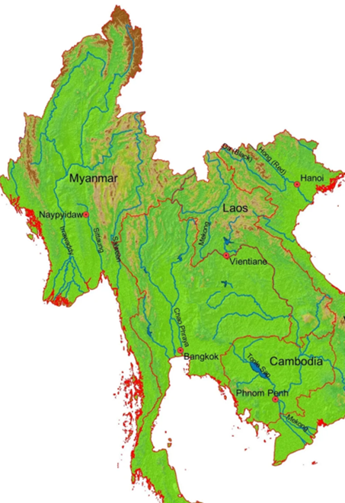



Historical footprints in South-East Asia
has established strong links and relationships with Health Authorities/counterparts from 2001 in Cambodia, 2005 in Lao PDR and 2010 in Myanmar to provide pragmatic expertise to fight infectious diseases in the field especially by strengthening the clinical laboratory sector in national health systems.
With an oriented vision of public health, relegating autonomy and developing sustainable projects with people-centered approach

Slide 6
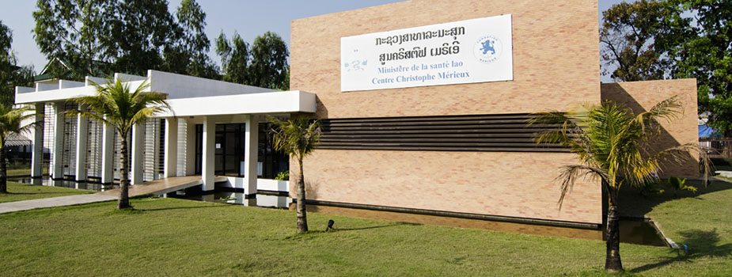
CILM in Laos PDR
Center for Infectiology Lao Christophe Mérieux with a Rodolphe Mérieux Laboratory (launched in 2009 and extended in 2017) on the scientific campus of the Ministry of Health, member of the GABRIEL network.
Rodolphe Mérieux Laboratory’s research focus: HIV/AIDS – chronic viral hepatitis – tuberculosis and viral respiratory infections – human papillomavirus (HPV) → will shift to Hepatitis diagnostic (RDT & PCR)
In 2019, First Laboratory in country to receive a double accreditation for its HIV viral load testing activities: one based on the ISO 15189:2012 standards on quality management and the other on the ISO 15190:2003 standards on biosafety management.

Slide 7
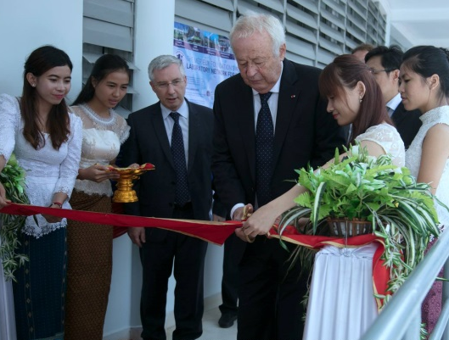
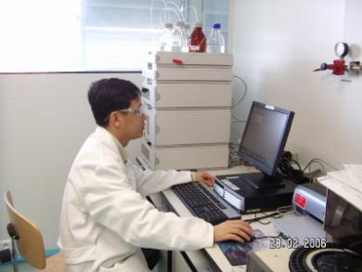
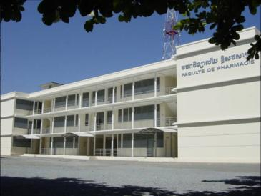
History of support activities to the University of Health Sciences (Cambodia)
2017 : Renovation of Rodolphe Mérieux Laboratory
2005 : Inauguration of Rodolphe Mérieux Laboratory
2003 : Inauguration of the Faculty of Pharmacy of Cambodia
Notes:
Rodolphe Mérieux Laboratory of UHS was first inaugurated in 2005 and re-inaugurated after the renovation in 2017.

Slide 8
Ongoing Research project (UHS) 2022-2023
Understanding the risks of zoonotic disease from swine production & exchange systems in Cambodia (PigFluCam+)
ANRS 12384 Community versus facility-based services to improve the screening of active HCV infection in Cambodia: a cluster randomized controlled trial (ANRS 12384 CamC) (Last follow up in Jan 2023)
Establishment of Risk Management Platform for Air Pollution in Cambodia (SATREPS)
Project FIND: Accelerating uptake of COVID-19 Ag RDTs in the Indo Pacific (Finished in Jan 2023)
SoGen project (extension): From social to genetic structures: a genome-wide approach in Southeast Asia
Prospective multicounty pneumococcal colonization research in children and adults Phase 2 (PCV II)
Seroepidemiology and Modelling to Support a Precision Public Health Approach in the Fight against Arboviruses and Zoonotic Viruses in Cambodia (Serocam) (drafting protocol and proposal)
Notes:
Since the creation of this lab, we handled more than 20 projects with our national and international partners.
For research activities from 2020 - 2021, there are 7 on going projects:

Slide 9
Research Expertise
Continue to support the activities of CILM (in Laos) and RML (in Cambodia) in terms of technical assitance, maintenance and infrastructure
Technical expertise - provided via a pool of international thematic experts (biosecurity and biosafety, virology, bacteriology, epidemiology, research, public health policy, laboratory and health infrastructure) based at the HQ in Lyon, France
Dedicated contribution from Scientific department of Fondation Merieux to local research projects and allowing host institutions to be a member of Merieux’s scientific network “GABRIEL”
Support to design and formulate the research projects in the SEA region (eg.. Conducting PPS (Point Prevalence Survey) in Laos PDR as a part of AMR/C/U scheme in coordination between local hospital workforce & international expertise)

Slide 10
Perspectives
Open to collaborative research project to promote the laboratory capacities and activities at CILM in Laos and RML in Cambodia as well as in Myanmar
Dedicated to one health surveillance in the region and strengthening the capacities of the laboratories – look forward to working collectively with partners
Open to having discussion with partners for the innovative research projects in the Region
Planning to establish and set up a wild life surveillance network in the region including a decentralization model of Genomic surveillance

Slide 11
Thank you!

